Slide 1
ISAAC MIZRAHI
By: Lucille Boco
Mrs. Troyanos
Fashion Design

Slide 2
Who is He?
Isaac is a famous fashion designer that made several famous fashion lines.
He was known for designing for Target, Liz Claiborne, and even for the first Lady Michelle Obama.
Nowadays Isaac could be seen on many talk shows including Ellen, and Opra and made clothe for shows like Sex in the City.

Slide 3
SKETCHES

Slide 4
The Beginnings
Isaac was born October 14, 1961 in Brooklyn, New York. He came from an Egyptian Jewish Family who were Clothing Manufacturers.
At a young age he was already interested in fashion. He would usually make clothes with his mother.
At the age of 10 his father gave him his first sewing machine. At the age of 15 he launched his “first” launch known as IS New York with help from a family friend.

Slide 5
Education
Isaac attended the Yeshivah of Flatbush. This school is a High School of Performing Arts. This school is a traditional Orthodox Jewish day school located in Brooklyn, New York.
Isaac then went to Parsons’ School of Design. This school is an art design school located in Greenwich, New York.
Notes:
S

Slide 6
How He Started
Isaac first presented his first fashion design in 1987 for a trunk show in a New York Department store called Bergdorf Goodman.
This first start soon became a big hit, and many fashion industries placed bids on Mizrahi’s work. His fashion style soon gained acclaim in the world.
In 1992, Chanel bought a portion of the company and continued to support Mizrahi and the company.

Slide 7
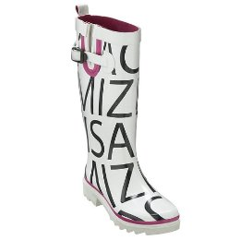

Slide 8
His Fashion Path
Isaac is known for being fickle in fashion designs. Every season he change his fashion design, making it hard for him to create his own unique “ Mizrahi” look.
Even though Mizrahi’s company line made some money ( about $10-$20 million) it also lost some money.
In 1998 Chanel pulled back their financing, costing the company to close after the Fall 1998 collection.

Slide 9
Fashion Career I
Even though his first company failed, Mizrahi also made many famous lines for other companies.
Mizrahi designed a line called ISC from 1995-1997. This label was meant to be cheap compared to the more expensive Mizrahi line. This project failed.

Slide 10
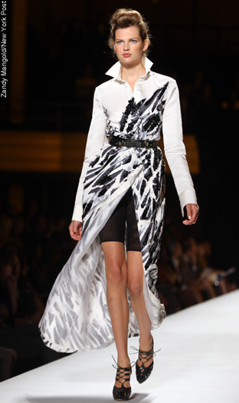

Slide 11
Fashion Career II
After 1998, Mizrahi returned to the fashion world in 2002 when he began designing a fashion line for Target. This line included not only clothes but beddings, house wares and pet products. The line was a success.
The sales made an estimate of $300 million and it introduced Mizrahi to mainstream America. The Target line ended in 2008 when Mizrahi joined Liz Claiborne.

Slide 12
Fashion Career III
The next company the Mizrahi joined is Liz Claiborne.
He only designed for Liz Claiborne for one year, from 2008 till 2009
The main reason is the failure for his line to launch. Although it was all over fashion magazine, the items in his line were very hard to find, and only certain stores carry any of his clothing.
Liz Claiborne is also rumored to be bankrupted since the closing of its site.

Slide 13
Mizrahi’s Design
As explained, Mizrahi is known for having “good and bad years.” This is mainly due to his fickleness in design. Every season he had a different line of design and style.
The style of his clothes are not flamboyant, and tend to be simplistic and elegant at the same time.
He also designed for movies and theater. His famous for being one the first lady Michelle Obama’s fashion designer.

Slide 14
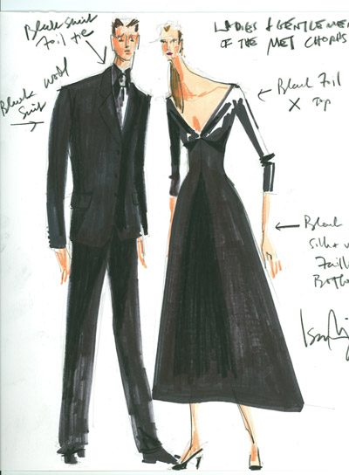

Slide 15
Awards and Shows
He won four CDFA awards.
Drama Desk Award for Women.
Mizrahi appeared in many shows such as Opera, Sex and the City, and Ugly Betty, and Celebrity Jeopardy.
He also made a documentary called Unzipped, a Broadway show called Lez Mizrahi, a book called How to Have Style, and a comic book called The Adventures of Sandee the Supermodel .

Slide 16
~Fin

