Slide 2
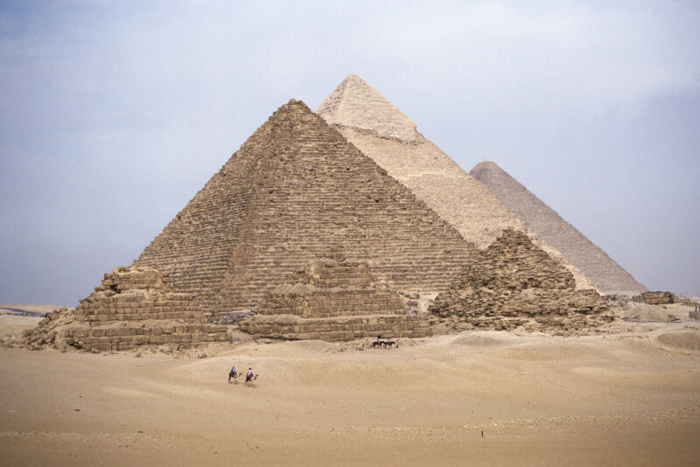
The ancient Egyptians were the first to use mathematics in art. It seems almost certain that they ascribed magical properties to the golden section (golden ratio, divine proportion, phi) and used in the design of their great pyramids.

Slide 3
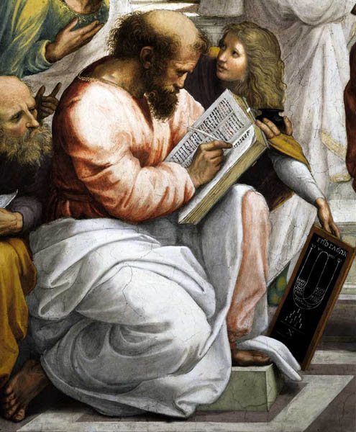
Pythagoras (560-480 BC), the Greek geometer, was especially interested in the golden section, and proved that it was the basis for the proportions of the human figure. He showed that the human body is built with each part in a definite golden proportion to all the other parts.
Pythagoras detail, from School of Athens by Raphael

Slide 4
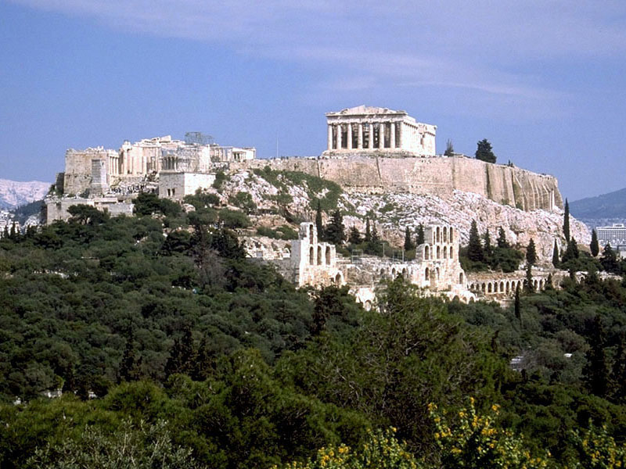
Pythagoras' discoveries of the proportions of the human figure had a tremendous effect on Greek art. Every part of their major buildings, down to the smallest detail of decoration, was constructed upon this proportion. Acropolis, Athens

Slide 5
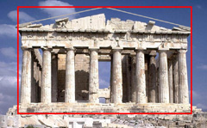
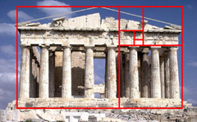
The Parthenon was perhaps the best example of a mathematical approach to art. Parthenon, Acropolis, Athens
Once its ruined triangular pediment is restored, .the ancient temple fits almost precisely into a golden rectangle.
Further classic subdivisions of the rectangle align perfectly with major architectural features of the structure.

Slide 6
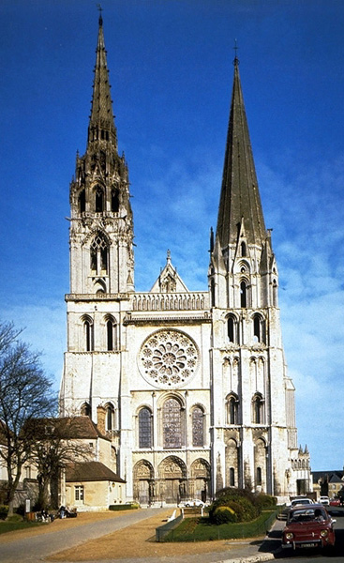
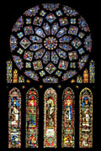
The Medieval builders of churches and cathedrals approached the design of their buildings in much the same way as the Greeks. A good geometric structure was their aim. Inside and out, their buildings were intricate constructions based on the golden section.
Chartres Cathedral
Rose Window, Chartres Cathedral

Slide 7
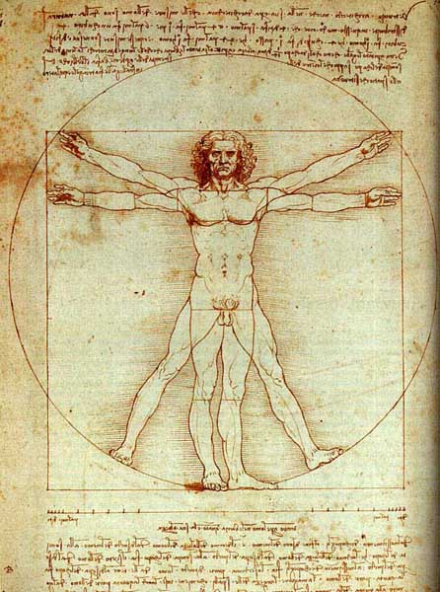
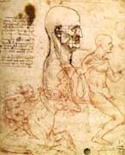
Leonardo da Vinci (1451-1519). Leonardo had for a long time displayed an ardent interest in the mathematics of art and nature. He had earlier, like Pythagoras, made a close study of the human figure and had shown how all its different parts were related by the golden section.
Study of Facial Proportions Study of Human Proportions

Slide 8
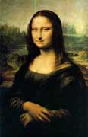
The golden rectangles in Da Vinci's Mona Lisa abound. Visit the web page Mona Lisa Applet to add golden rectangles interactively to his famous masterpiece.

Slide 9
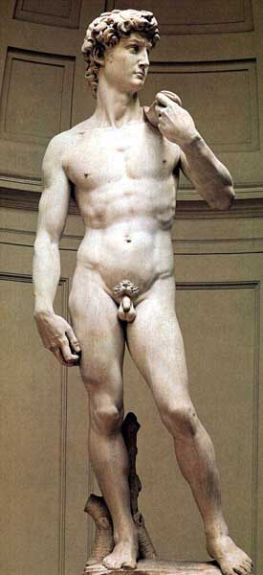
Hacking back to classical themes and techniques for their inspiration, artists of the Renaissance like Michelangelo (1475-1564) and Raphael (1483-1530) once more began to construct their compositions on the golden ratio. The proportions of Michelangelo's David conform to the golden ratio from the location of the navel with respect to the height to the placement of the joints in the fingers. Visit the web page Florence and Human Proportion for more details.

Slide 10
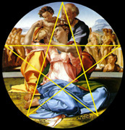
Michelangelo's Holy Family ...is notable for its positioning of the principal figures in alignment with a pentagram or golden star.

Slide 11
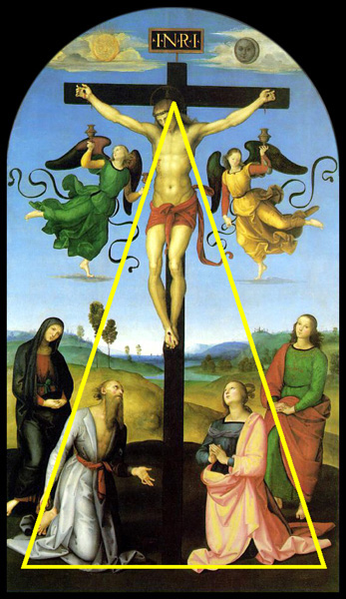
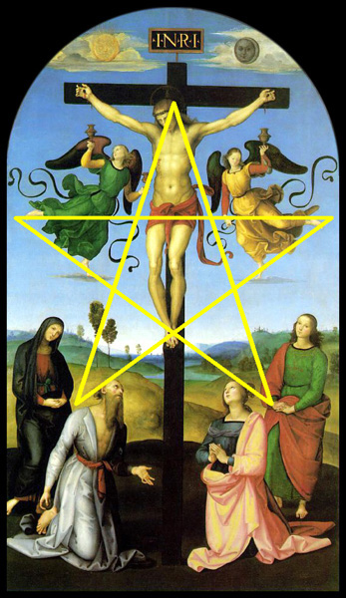
Raphael's Crucifixionis another well-known example. The principal figures outline a golden triangle .. which can be used to locate one of its underlying pentagrams.

Slide 12
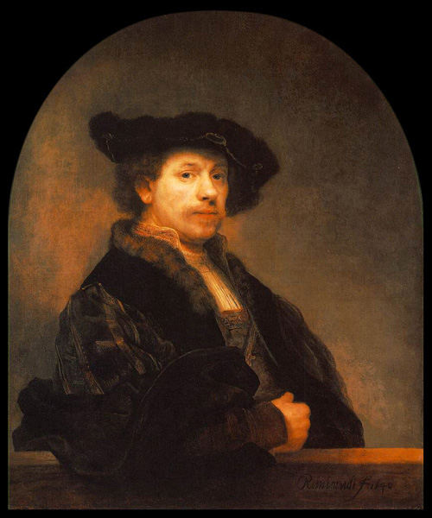
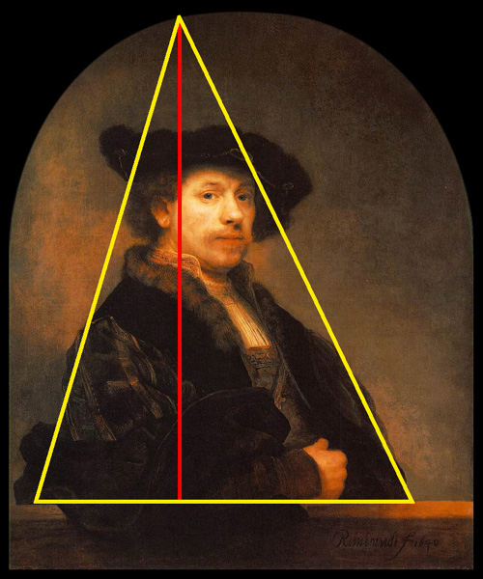
This self-portrait by Rembrandt (1606-1669) is an example of triangular composition - holding together an intricate subject within three straight lines. The different lengths of the sides add a little variety. A perpendicular line from the apex of the triangle to the base would cut the base in golden section.

Slide 13
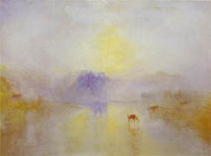
The English romantic artistic Joseph Mallord William Turner (1775-1851) is admired for his use of color and light.
Norham Castle at Sunrise

Slide 14
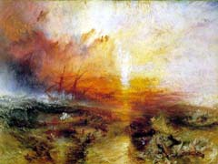
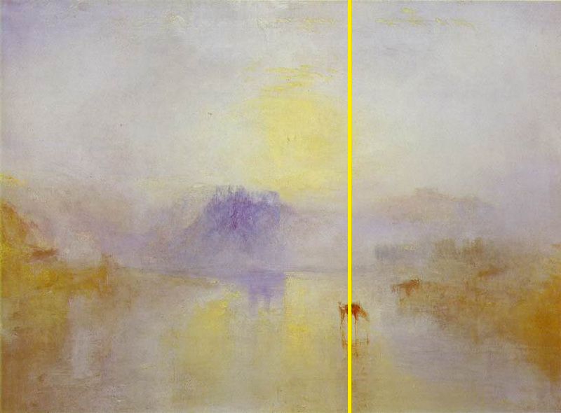
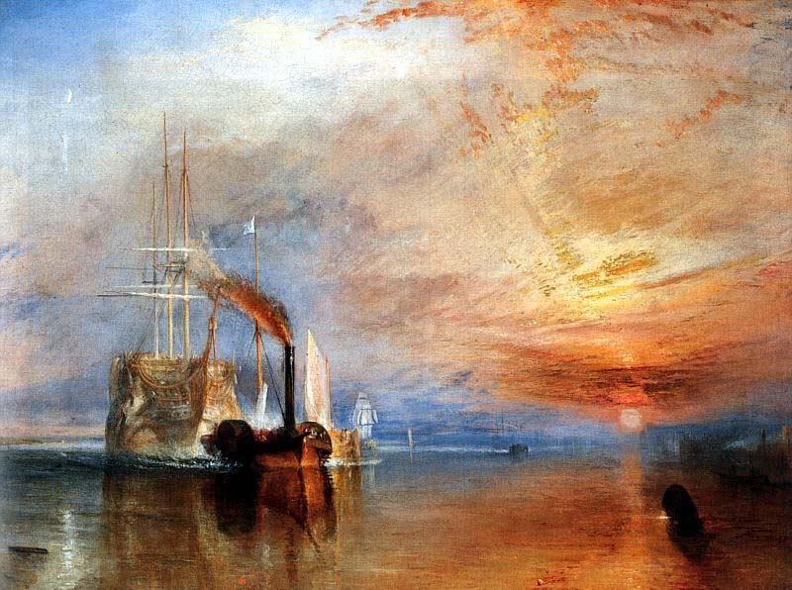
Of particular interest are the geometric similarities in his various canvases, with their obvious golden subdivisions.

Slide 15
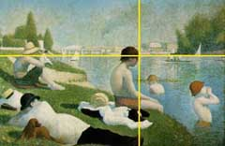
According to one art expert, Seurat "attacked every canvas by the golden section". His Bathers has obvious golden subdivisions.

Slide 16
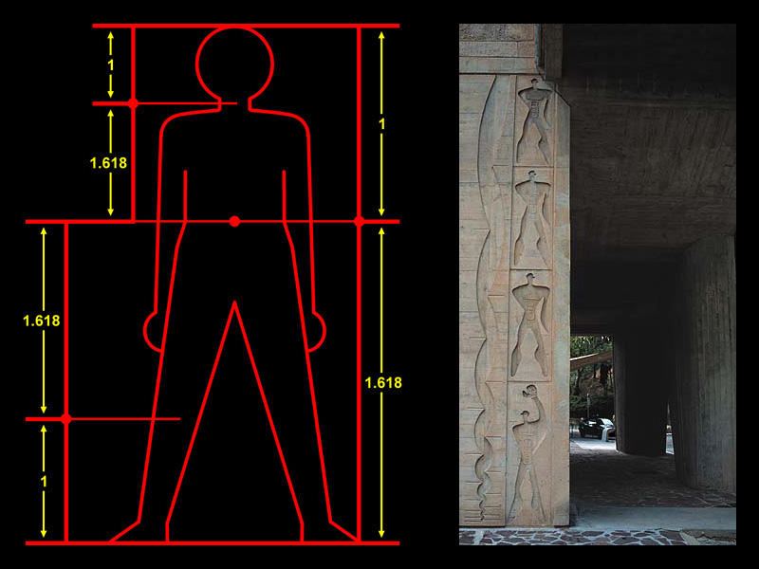
The 20th Century architect Le Corbusier (1887-1965) developed a scale of proportions which he called Le Modulor, based on a human body whose height is divided in golden section commencing at the navel.

Slide 17
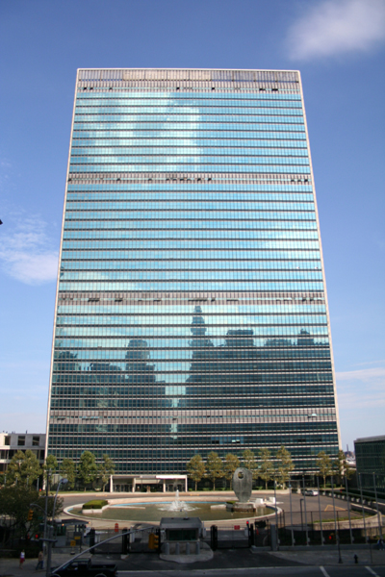
Today architects are still frequently using the golden section in their work. In the United Nations building, the ratio of width of the building compared with the height of every ten floors is golden.

