Slide 1
History of Teaching Art Term Project
By
Debra Troyanos

Slide 2
I drove to davis art company in worcester mass, which is 2.5 hours drive from cape cod each way

Slide 3
Davis publishing still exists in the old printers building in worcester

Slide 4
Historical Building details

Slide 5
I met the president of the company, and other members of the davis/school arts team.
Wyatt Wade

Slide 6
First I toured the offices…

Slide 7
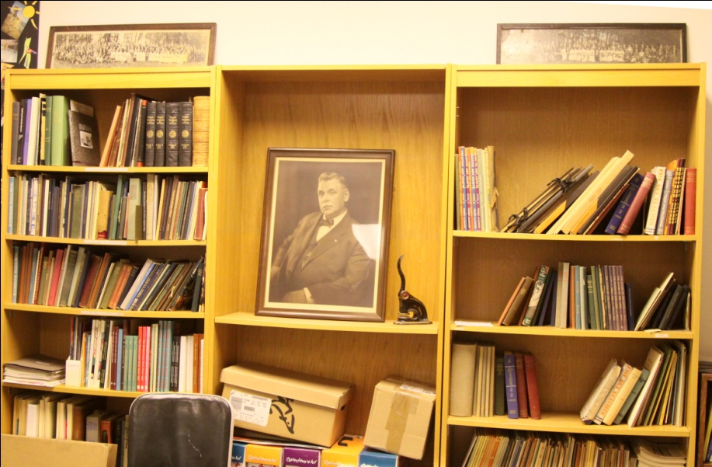
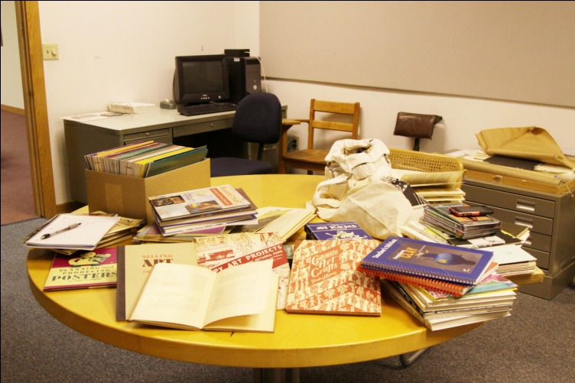
Then I spent six hours pouring over the historical archives

Slide 8
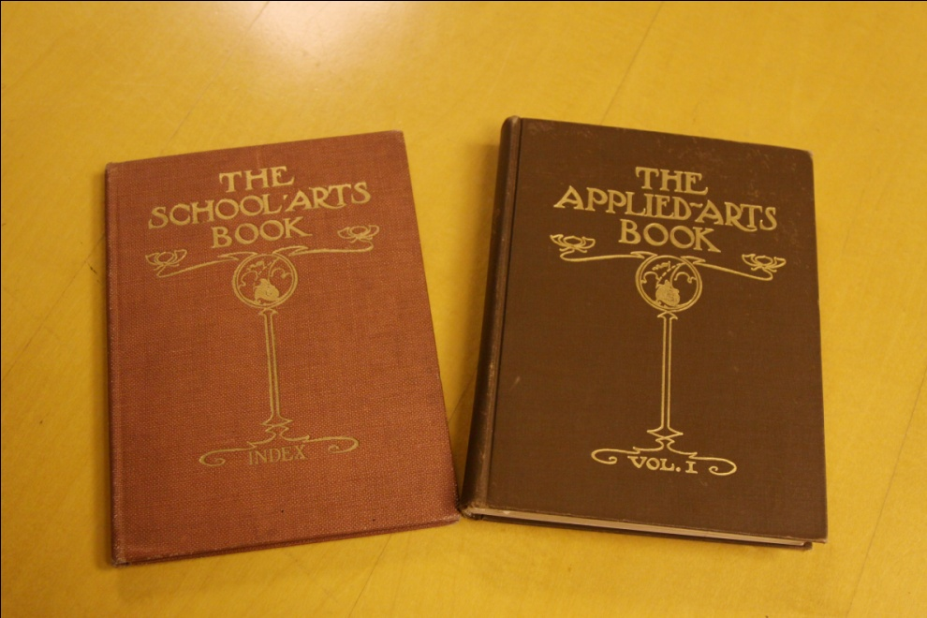
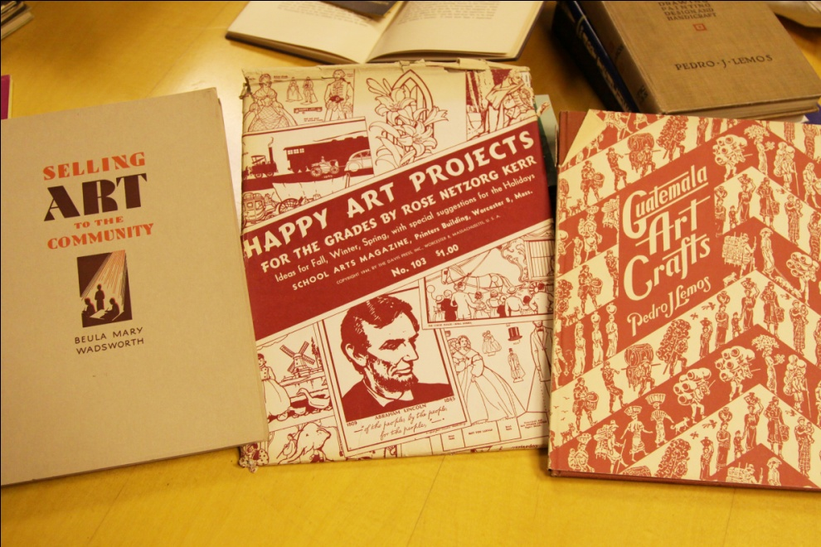
I read for six hours!!-
I looked through beautiful old First Edition books printed for art educators for the entire century- a big task!!! Six hours was clearly not enough time.
I saw the original “The Applied Arts Book” that eventually became School Arts Magazine.

Slide 9
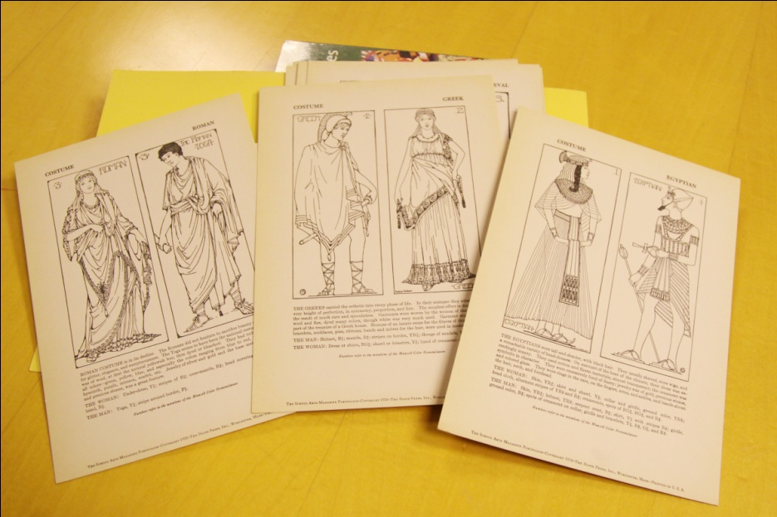
The portfolios made for classrooms were interesting- but smaller than I expected (only about 5”x7”)

Slide 10
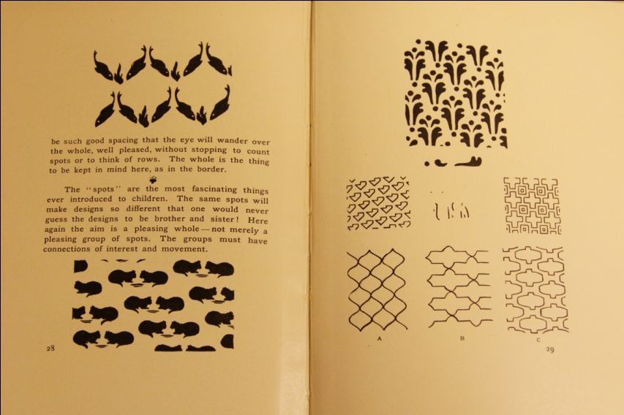
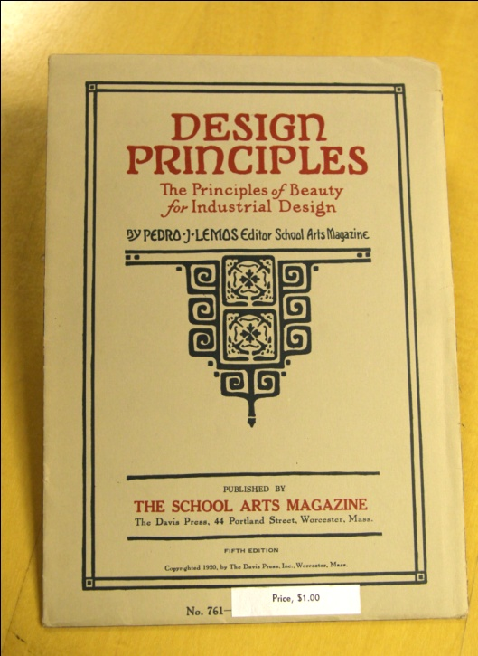
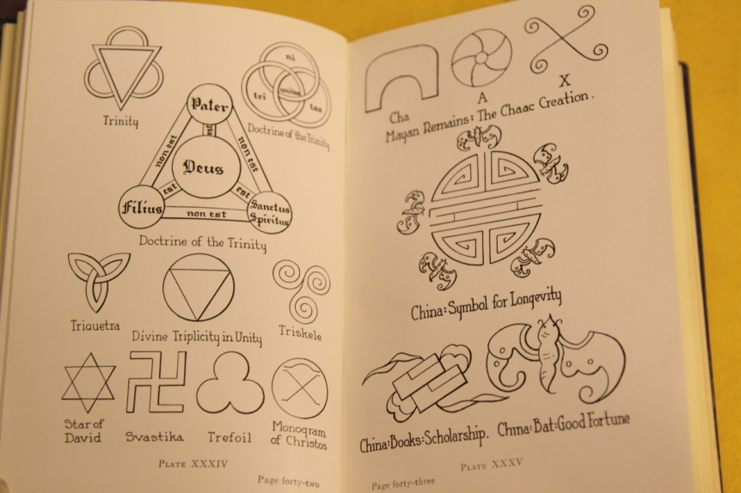
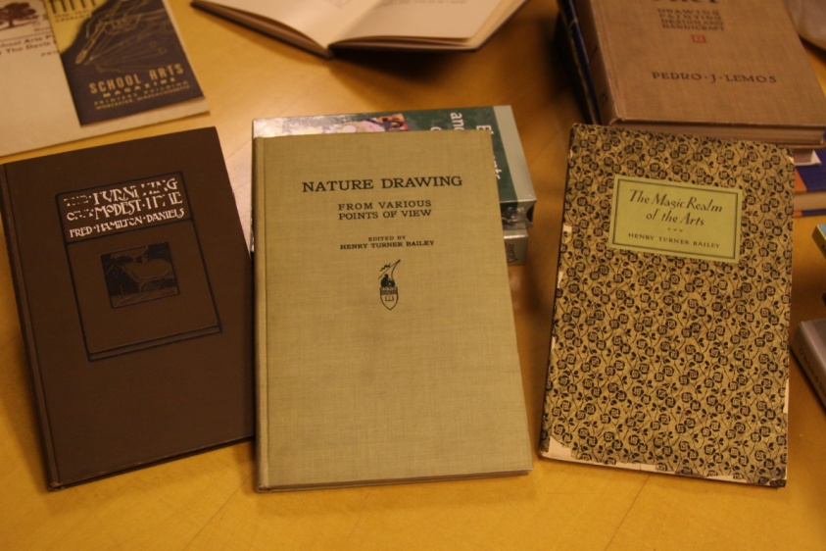
I saw examples of all the teaching methods we’ve learned in class- industrial drawing, holiday art, elements of art, aesthetics, and more…

Slide 11
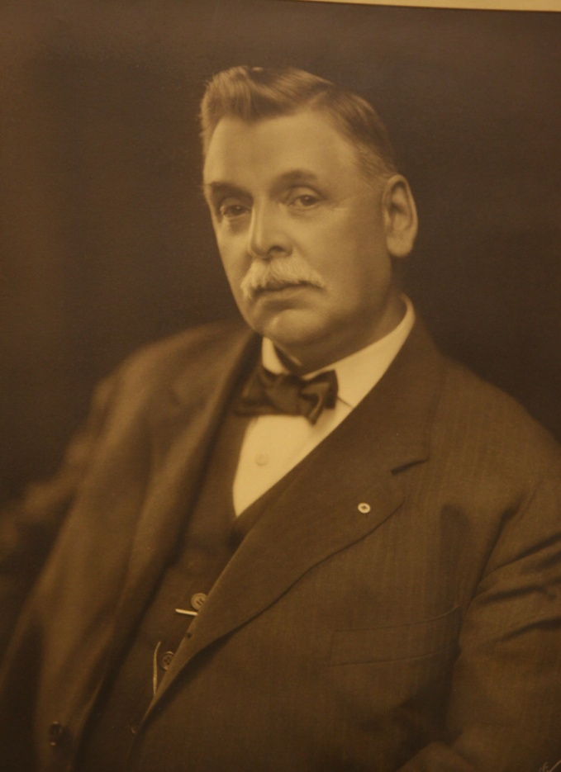
The portrait of Gilbert davis, one of the founders,kept me company while the hours went by…

Slide 12
I was not allowed to remove any books so had to study them all during this visit

Slide 13
Other books on art education
This page encouraged teachers to demonstrate drawing first, and to be one of the students in all your work. It states “have the children watch you work, and let them criticize your drawing.”

Slide 14
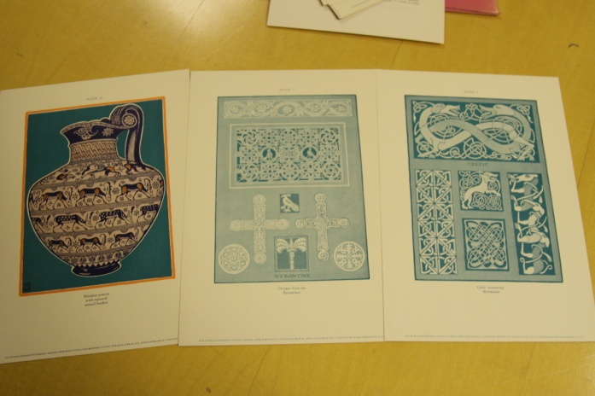
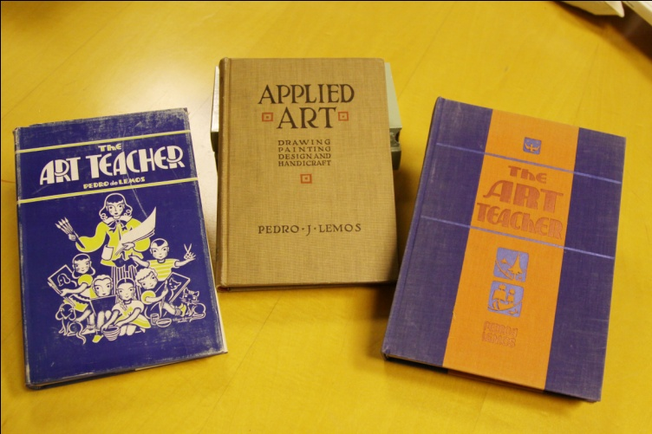
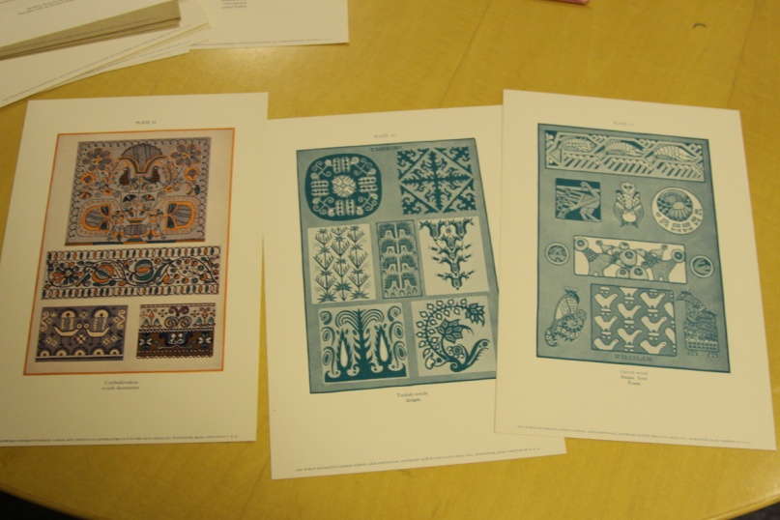
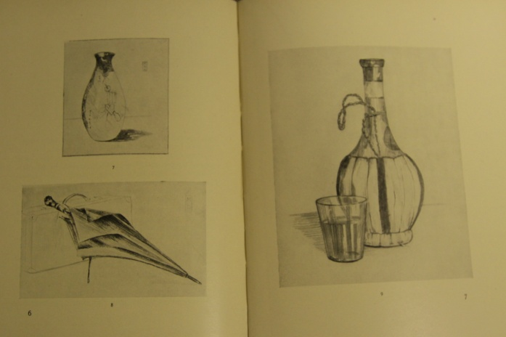

Slide 15
Conclusions
The archives contained the books, text books, and School Arts magazines from the past century published by Davis Publishing. However, it did not have a great deal of information about the history of the company itself.
For that, I was directed to contact two researchers who had inquired and done research on the topic in the past.
The first was the author of our textbook, Mary Ann Stankiewicz, who once did a 2-hour presentation on the history of the Davis Company for NEA in New York. I wrote to her, however she did not answer back as of this writing.
I also contacted a second person Davis recommended but did not hear back from her either. Unfortunately there was not enough time for her to respond either.
The topic could be so vast, it could be done as a much larger project at another time in the future, but was too large in scope to do it justice in less than two weeks time I had left in the course.
I was impressed with the warmth, hospitality and supportiveness of the Davis Company and their level of commitment to art educators continues today.

Slide 16
My project
I intended to research how the Davis Art Co. intertwined with the history of Art Education. I wanted to do personal interviews with the President of Davis and the Editor of School Arts.
I thought I would create some sort of timeline link Davis Co. could add to their website, or perhaps write an article about it for the magazine. I ended up creating the timeline.

Slide 17
Here is the link to the timeline:
The History of Art Education through
Davis Art Publishing Company
http:/www.dipity.com/Troyanos/History-of-Teaching-Art-with-Davis-Co/

Slide 18
It was a pleasurable day researching the history of art education through the archives of over 100 years of publishing at davis art co.

