Slide 1
How Artists Portray Humans & Nature
Created By
Debra Troyanos

Slide 2
View these artworks & think about:
What story is being told here? Who are these people? Where are they? What will happen next?
Does this look like a scene that looks similar or different from where we live?
Notice how the artist expresses a mood or emotion? Is it conveyed by color? Composition?
How does the artist portray nature as positive or negative in this image?
What is the scale of humans to the environment? Why?
Does the artist make a social statement? If so what are they trying to say?

Slide 3
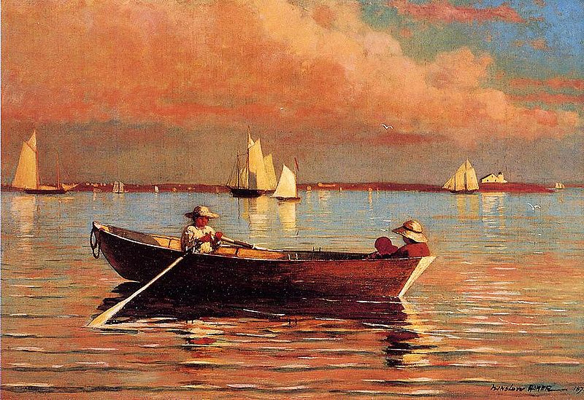
Winslow Homer
Gloucester Harbor

Slide 4
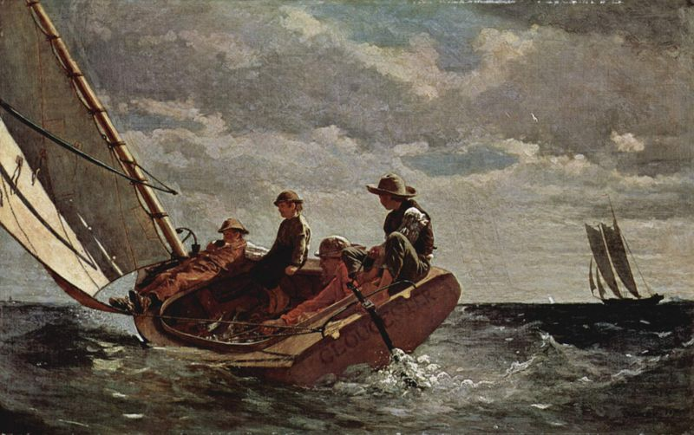
Winslow Homer
Breezing Up

Slide 5
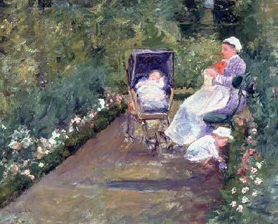
Mary Cassatt
The Nurse

Slide 6
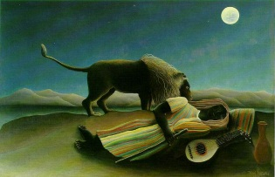
Henri Rousseau
The Sleeping Gypsy

Slide 7
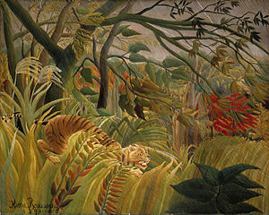
Tiger In A Tropical Storm (Surprised!)

Slide 8
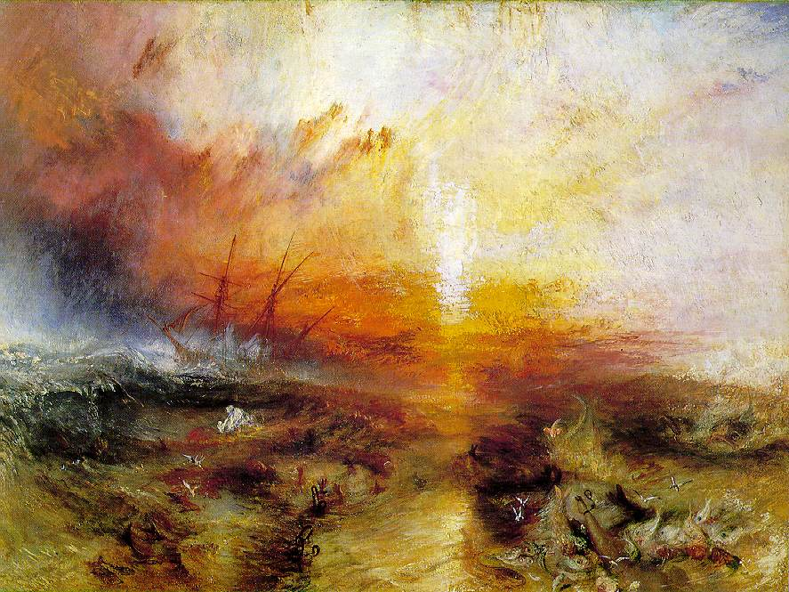
Joseph Mallord William Turner
The Slave Ship

Slide 9
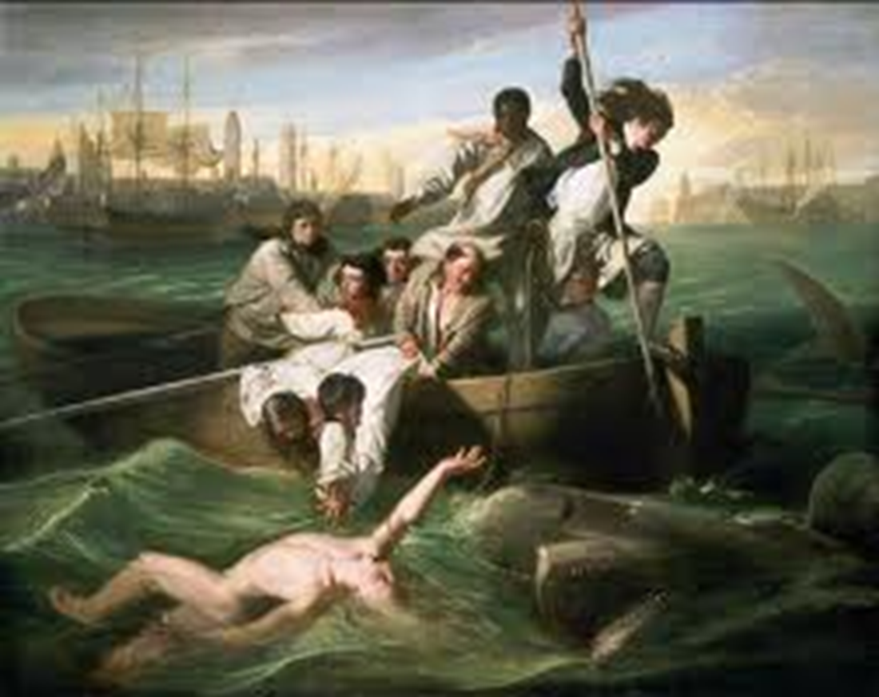
John Copley
Watson & The Shark

Slide 10
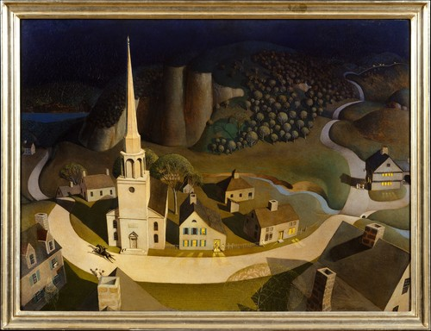
Grant Wood
Paul Revere’s Ride

Slide 11
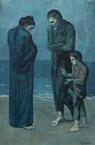
Pablo Picasso
Tragedy

Slide 12
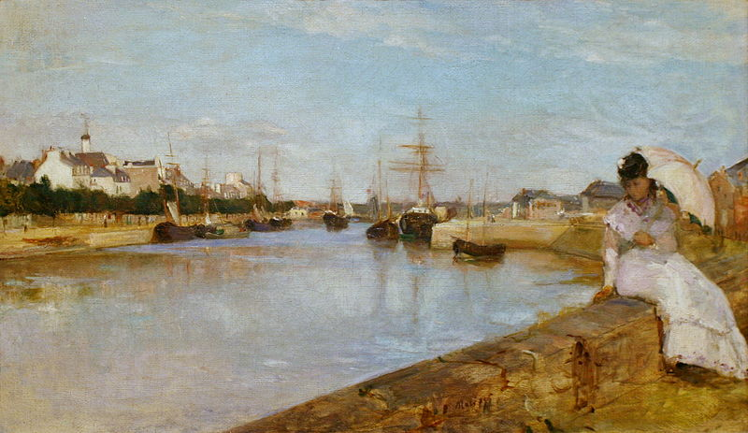
Berthe Morisot
The Harbor at St. Laurient

Slide 13
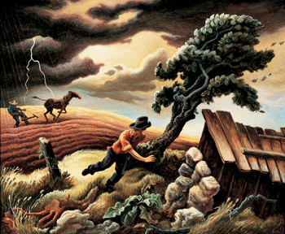
Thomas Hart Benton
The Hailstorm

Slide 14
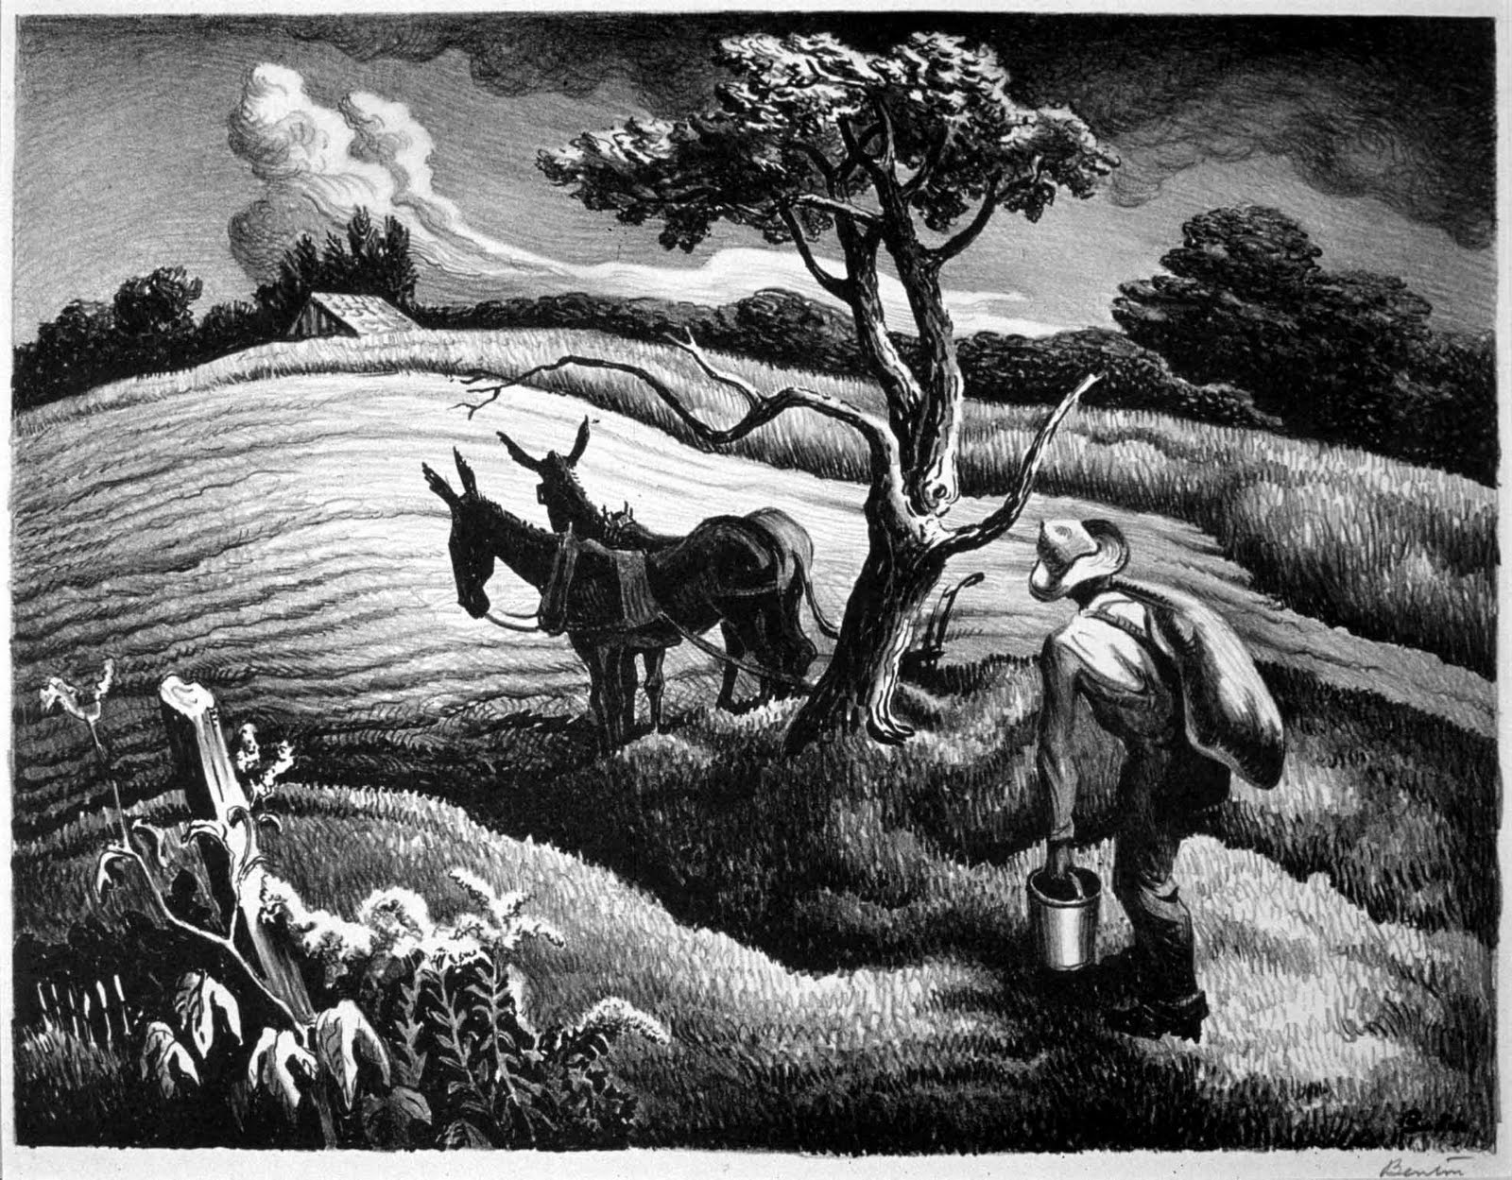
Thomas Hart Benton
Approaching Storm

Slide 15
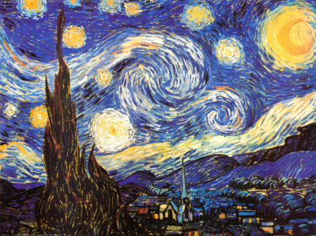
Vincent Van Gogh
The Starry Night

