Slide 1
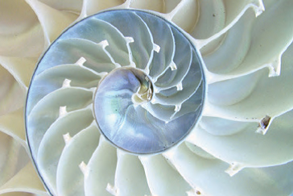
The Beauty of The Golden Ratio In Art
by Debra Troyanos

Slide 2
The Golden Ratio is also known as:
The Golden Proportion, The Golden Mean or
The Divine Proportion

Slide 3
It is found everywhere in Nature and is believed to be the proportion of creation
Spiral of Hurricane Irene

Slide 4
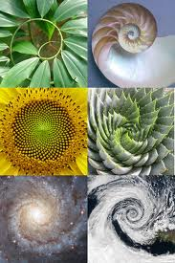
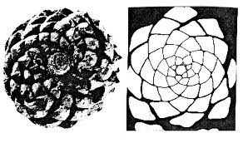
It is found in seashells, plants

Slide 5
It is seen in the design of the cosmos, our universe

Slide 6
The Golden Ratio is considered the most pleasing to the human eye, and the proportions are what we intuitively feel is beautiful.
It can be found in nature, art, music, poetry, architecture, mathematics, and more.

Slide 7
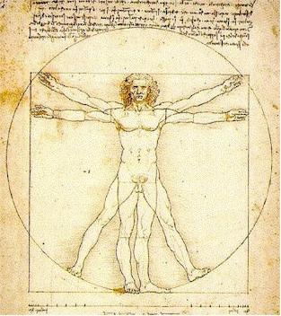
It is seen in humans, our body and face proportions

Slide 8
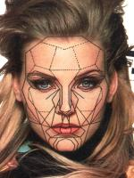
Even our DNA….

Slide 9
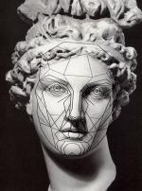
After it was discovered, artists such as Leonardo DaVinci used it in their art

Slide 10
Artists have used it as a means to show balance and harmony in their work in an aesthetically pleasing way.

Slide 11
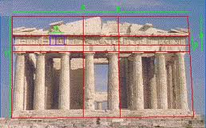
It was used in creating some of the most magnificent architecture such as the Egyptian Pyramids, The Greek Parthenon.

Slide 12
Artists and Designers Today Use The Golden Ratio to create logos, brands, products websites ,and advertising using this knowledge of our aesthetic preference to the Golden Ratio. The more visually appealing it is, the more we want it.

Slide 13
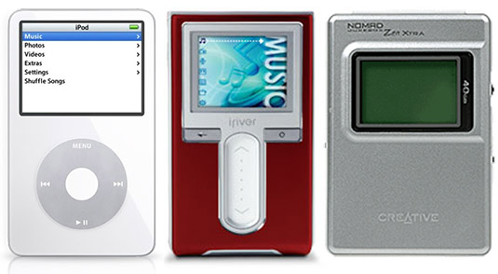
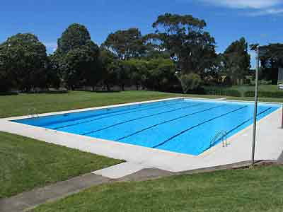
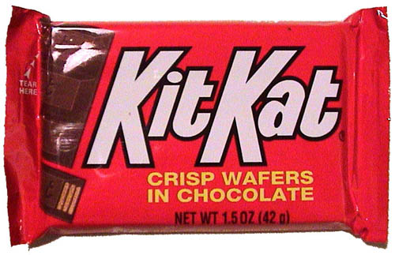
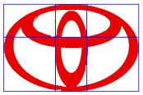
Some items created using the Golden Ratio

Slide 14
We often use this ratio in composing photographs or artwork using the Rule-of-Thirds in determining where to place the horizon line and subject.

Slide 15
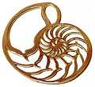
Other contemporary artists use the Golden Ratio in creating and composing other types of art such as basket-weaving, quilt-making, furniture design, jewelry design, website design and more.

